Slide 1
Project 4: SAP Prediction
By: Abdullah Tanveer, Hakeem Yatim, Mitsuki Shimonishi

Slide 2
Problem
Build an algorithm for each query object that will guess the brand of each particle in a query object.
Keep Dr. Hietpas’ conjecture that the post-blast recovered sample will tend to have fewer smaller particles due to those particles being more easily consumed in the blast in mind
Take into account for the differing distribution of particles for the unexploded vs exploded query objects

Slide 3
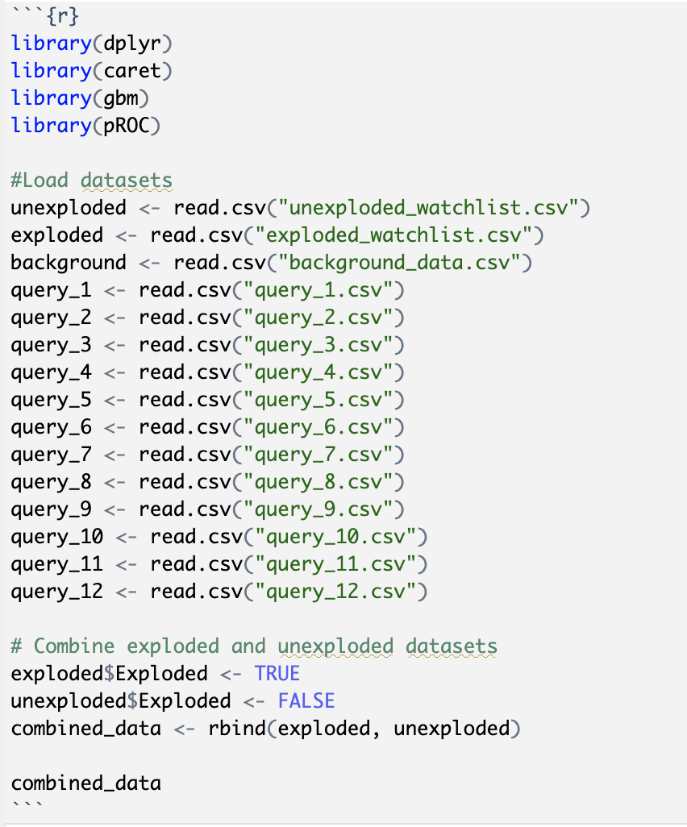
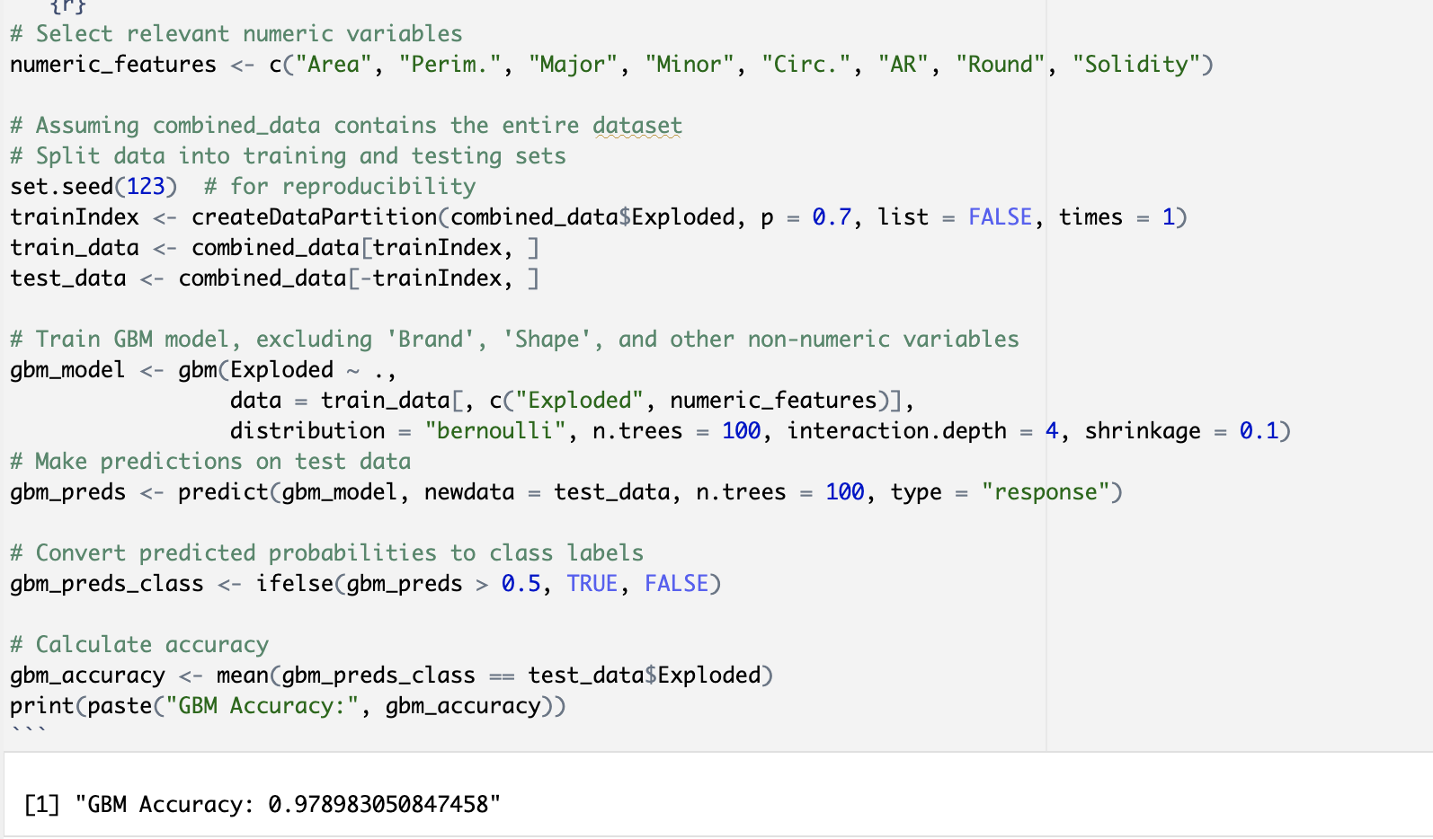
Data Preprocessing
We loaded up the data like in Project 3, and used the GBM model we built that predicted exploded vs unexploded in the combined dataset.
Wanted to focus on 5 brands, but need to take other brands into consideration in background dataset

Slide 4
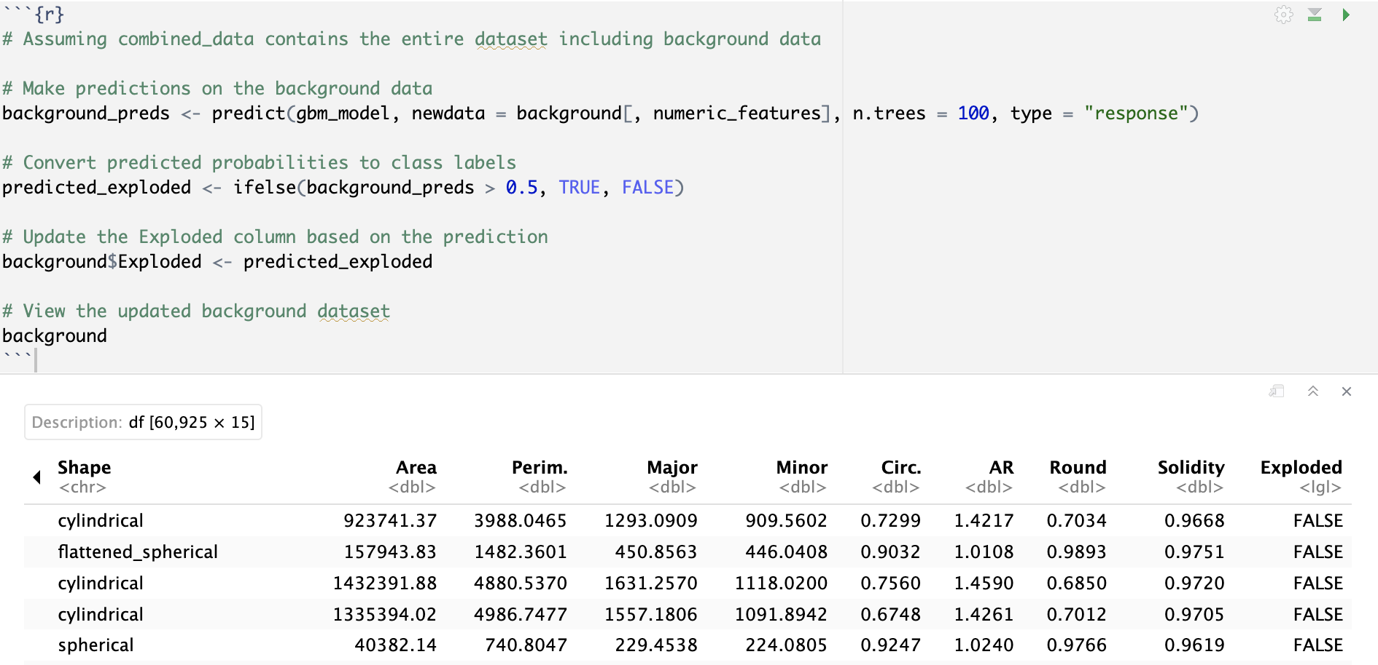
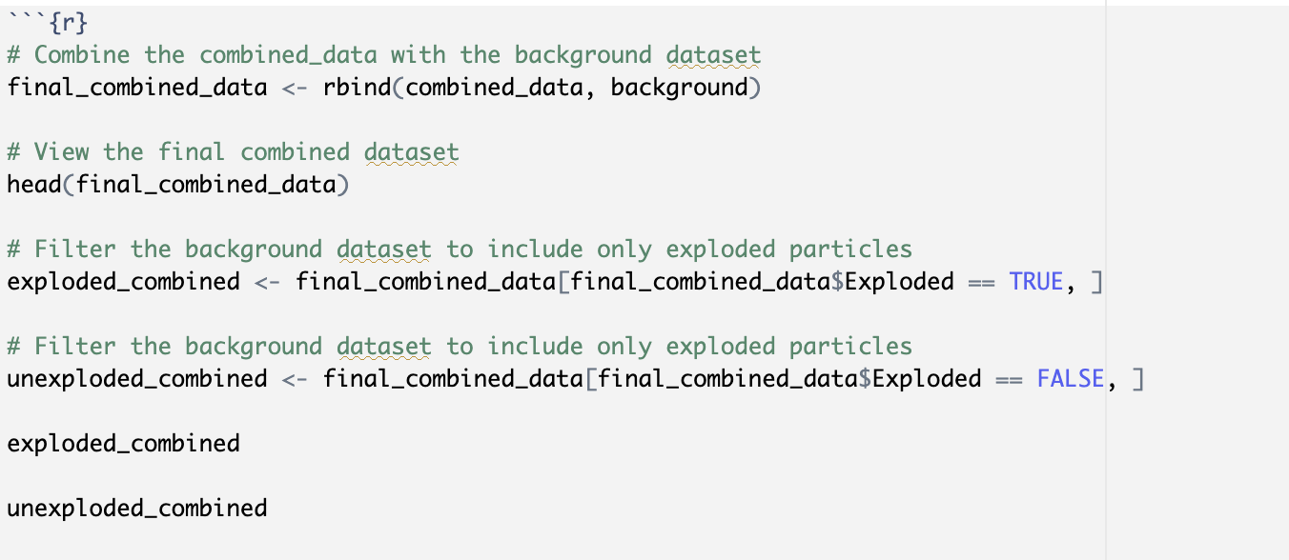
Data Preprocessing
Background dataset was supposed to be unexploded, but due to Dr. Hietpas’ conjecture, they might have misclassified them as unexploded, so we can use our exploded vs unexploded model to predict if the particles are exploded or unexploded in background data
After making the predicted data of unexploded vs exploded, we combined all three data and separated them again with one being the final exploded data, and one being the final unexploded data
We need to separate the unexploded vs exploded due to us trying to build 2 models.

Slide 5
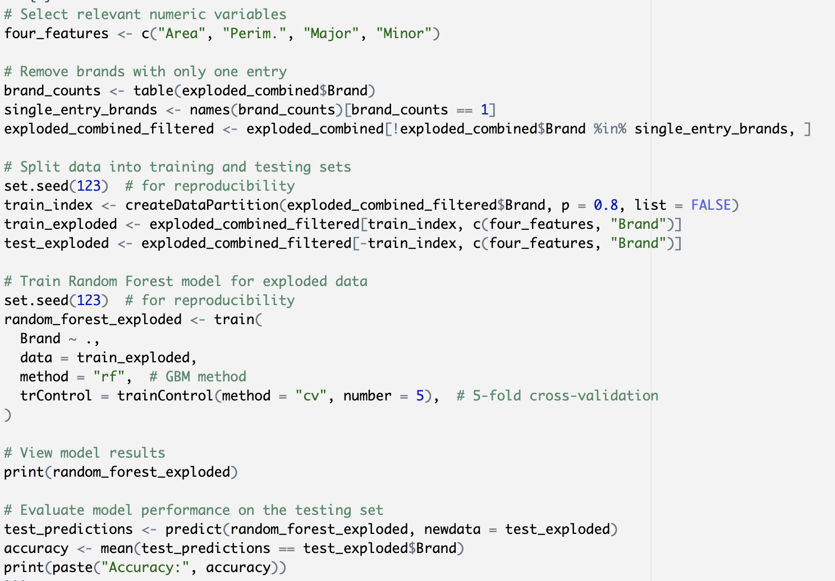
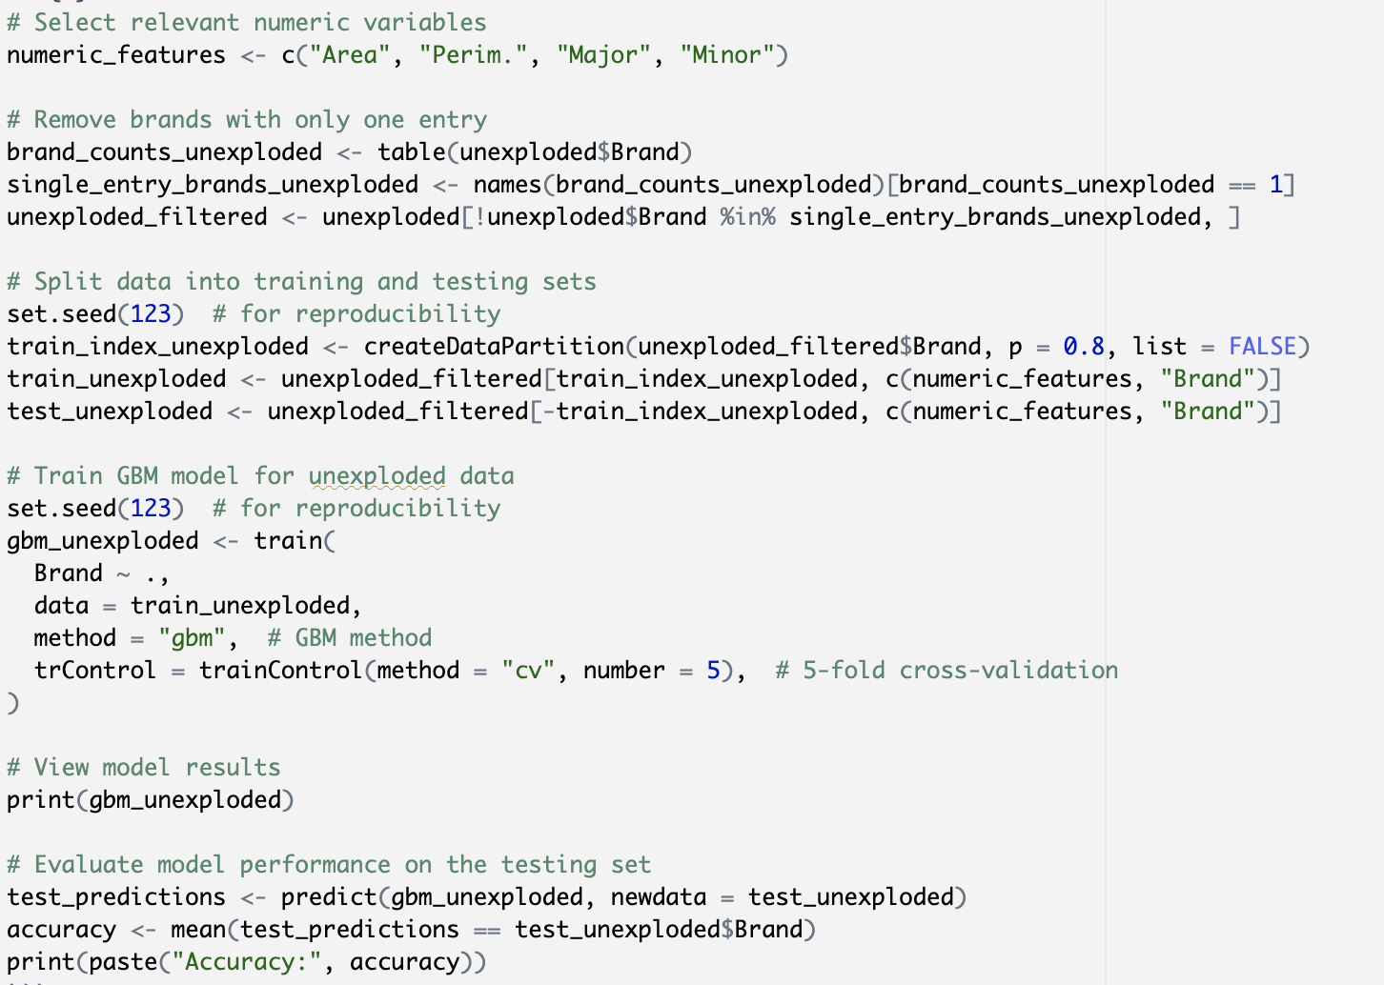
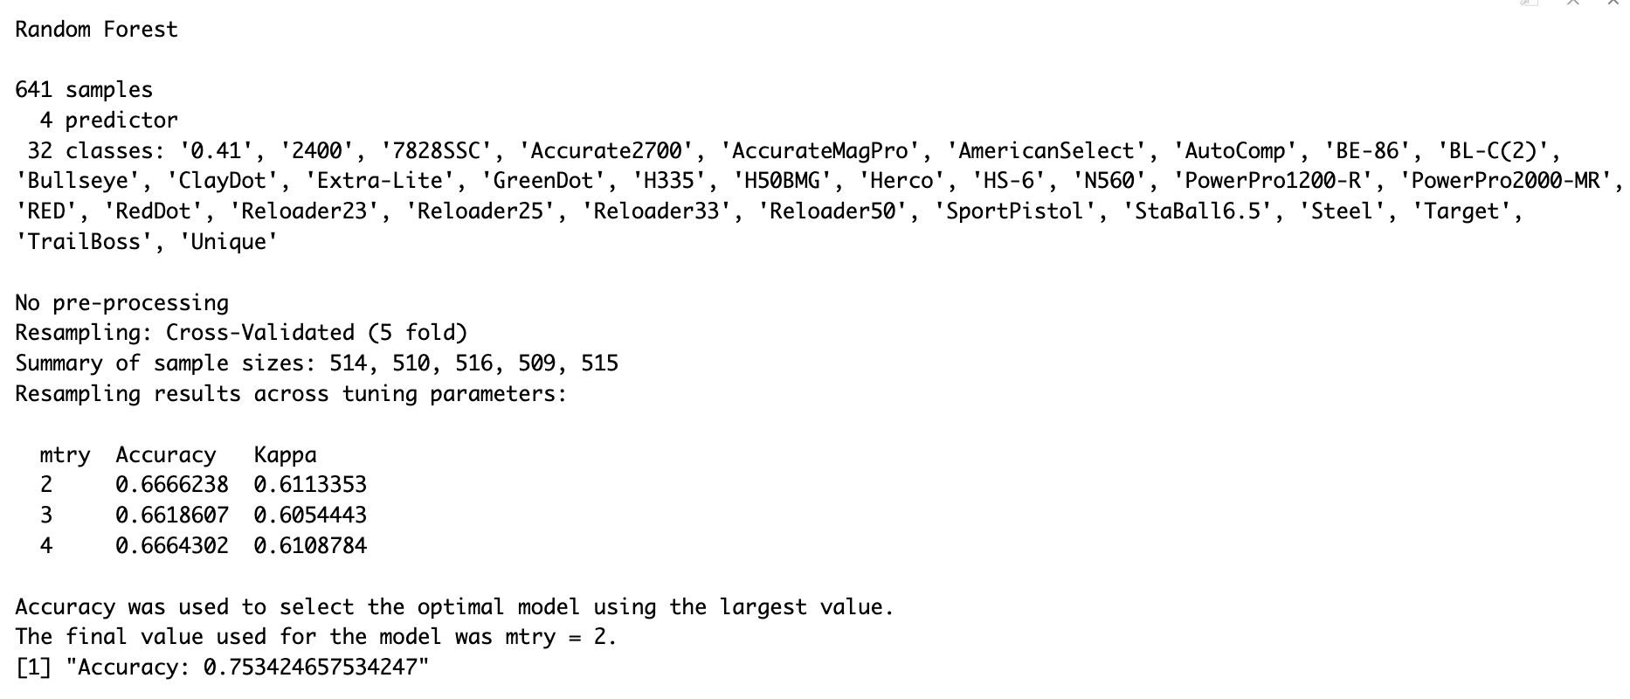
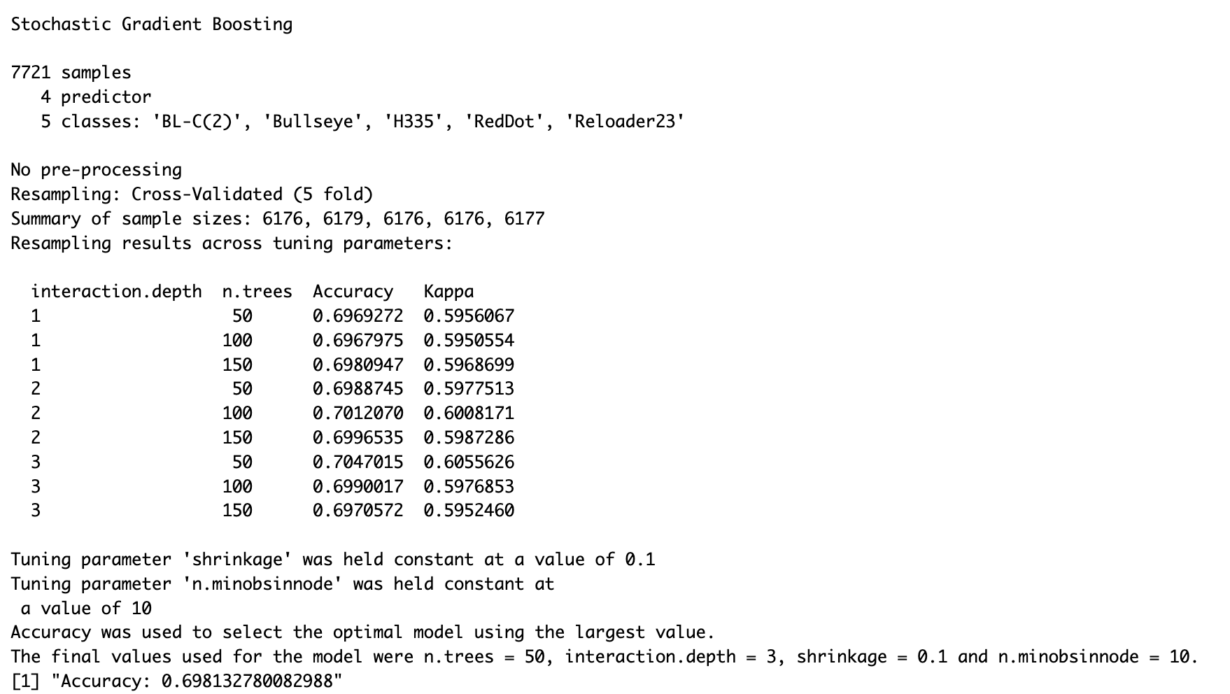
Model Building
2 models: 1 for exploded data and 1 for unexploded data
Random Forest Model for Exploded data, GBM for Unexploded data
Decided to remove brands with a single entry since the model wouldn’t work and it would improve the model’s performance
Accuracies of 75% and 70% respectively
Tried to evaluate the model but had difficulties computing confusion matrix, precision, recall, f1

Slide 6
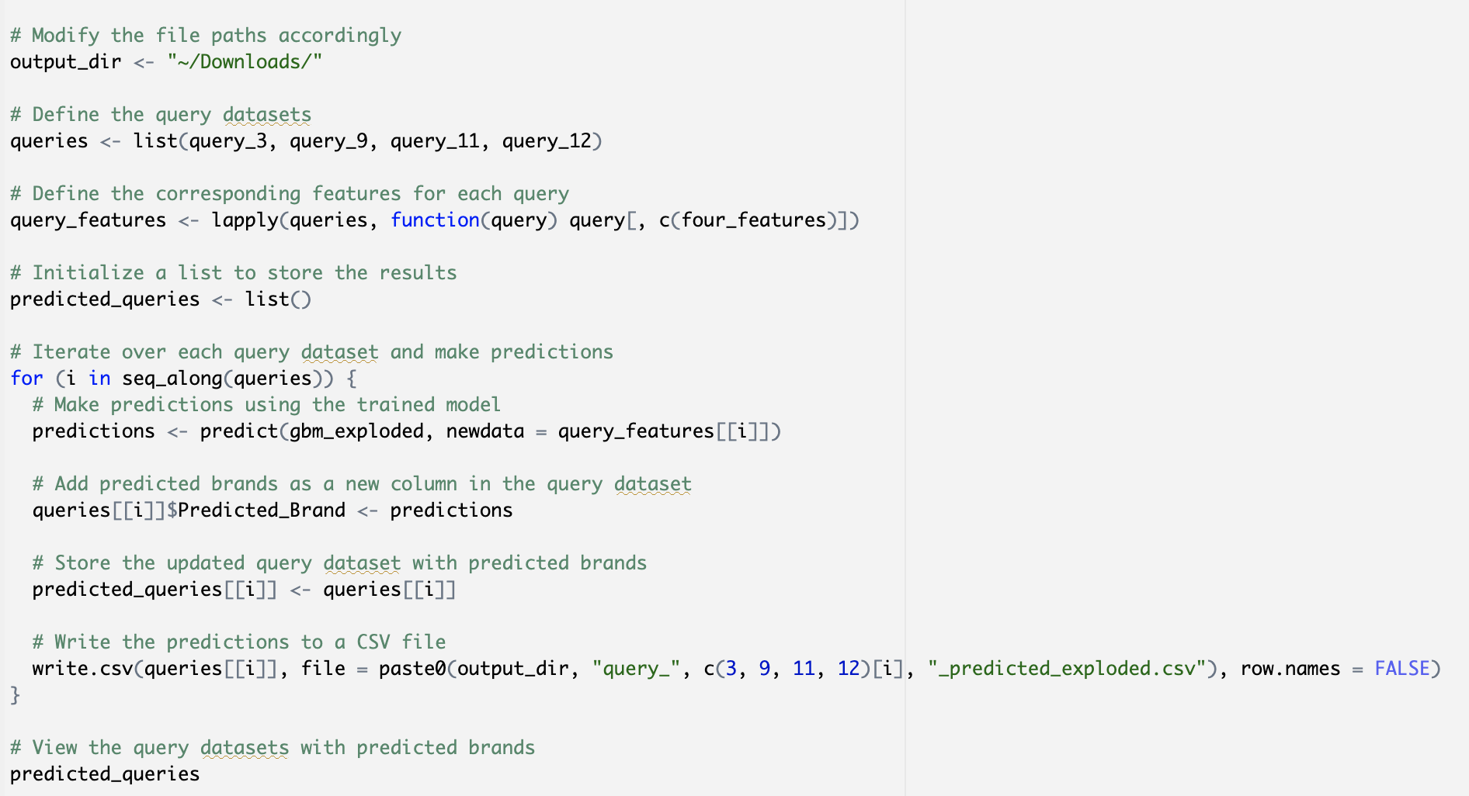
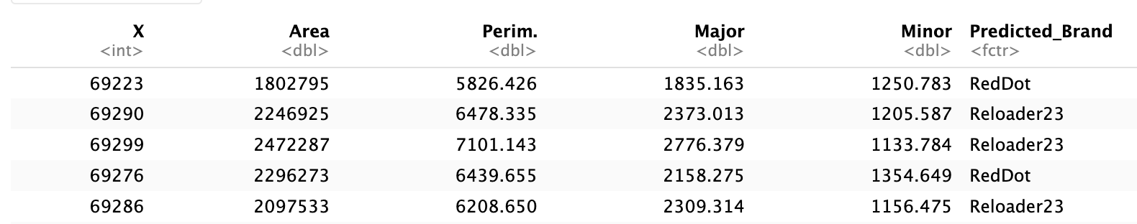
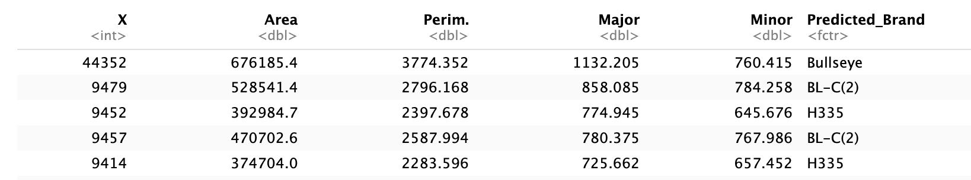
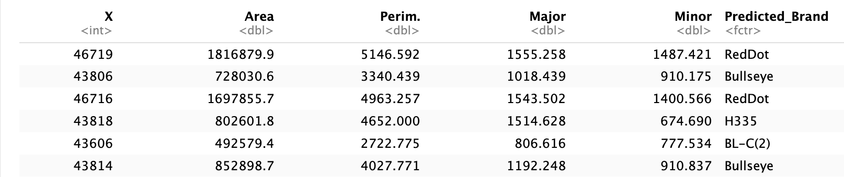
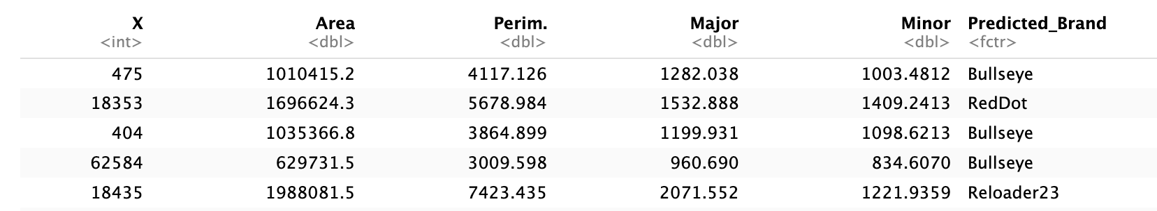
Brand Predictions Exploded
Used the model to predict on the exploded queries (3,9,11,12)
Output them as a csv files
Query 3
Query 11
Query 9
Query 12

Slide 7
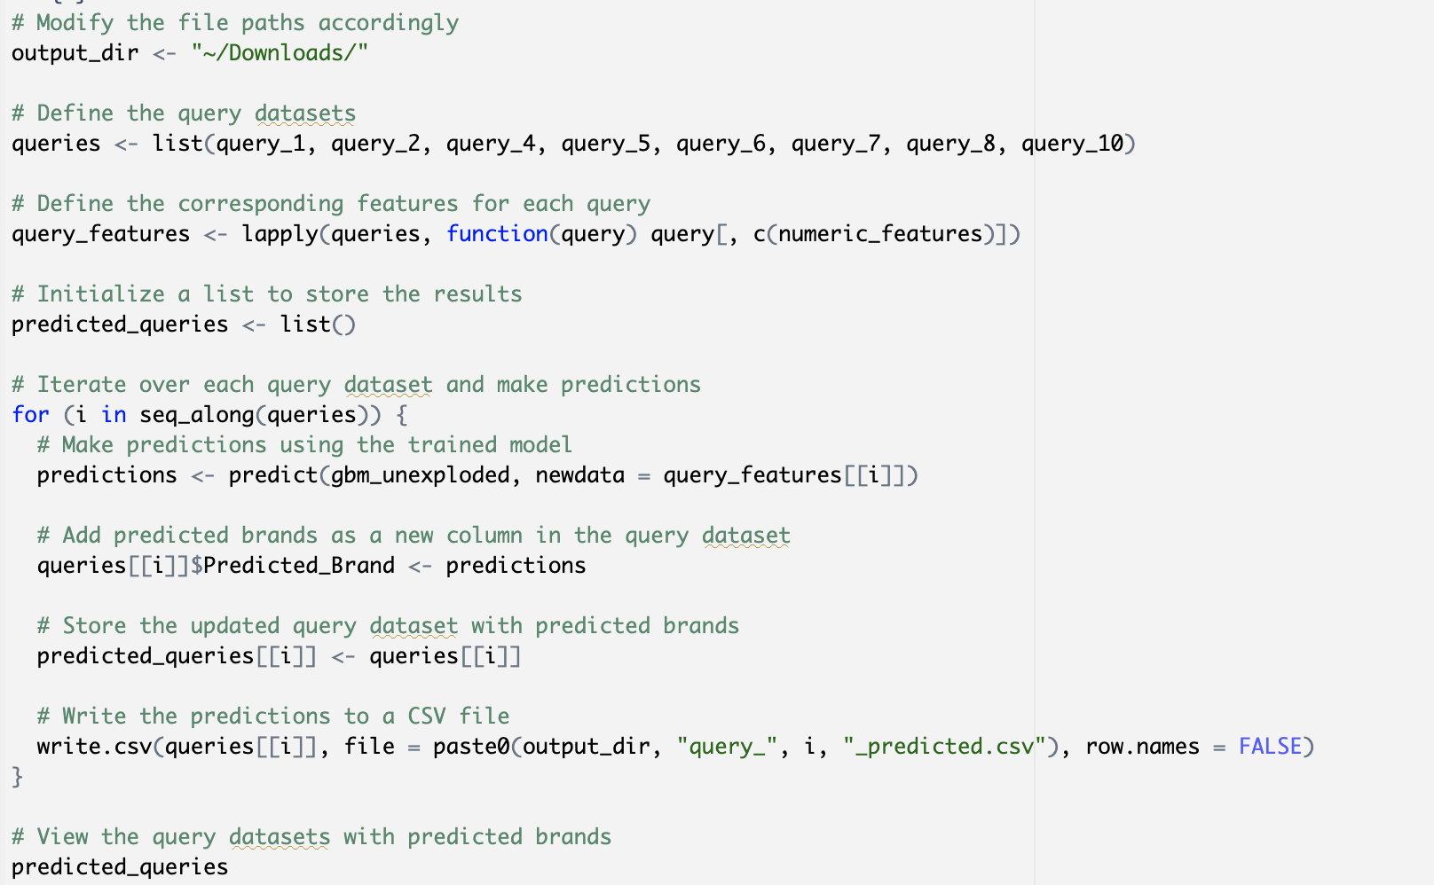
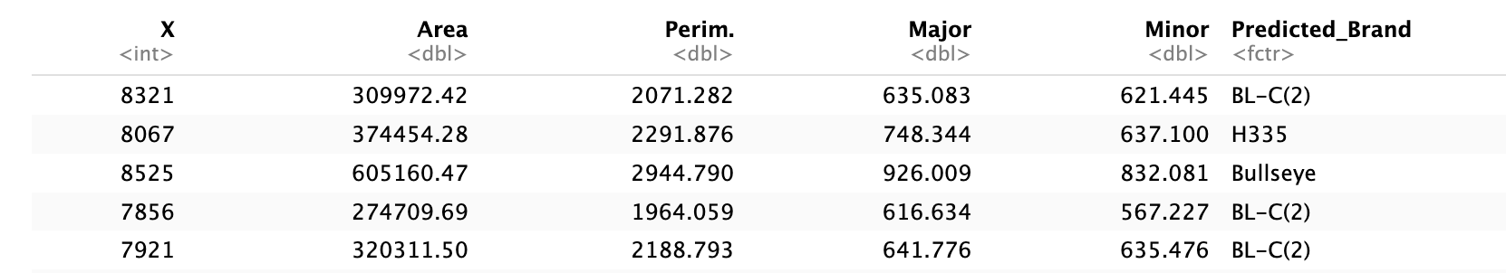
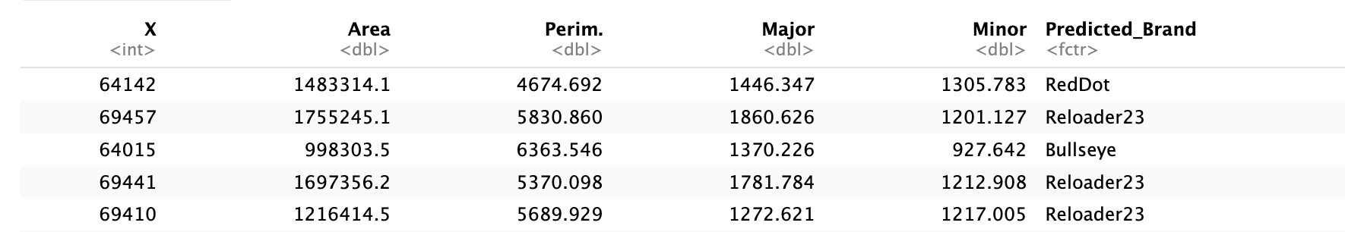
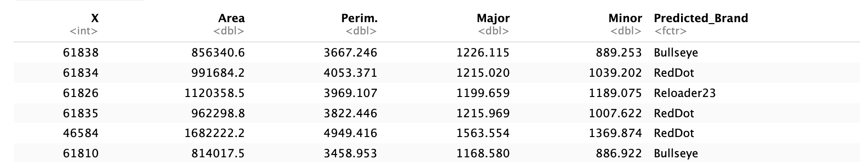
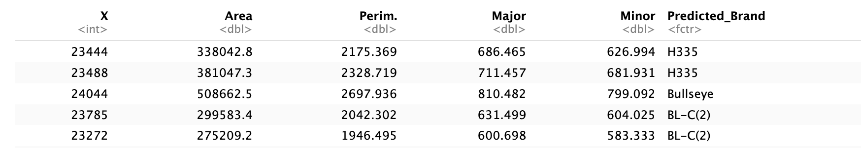
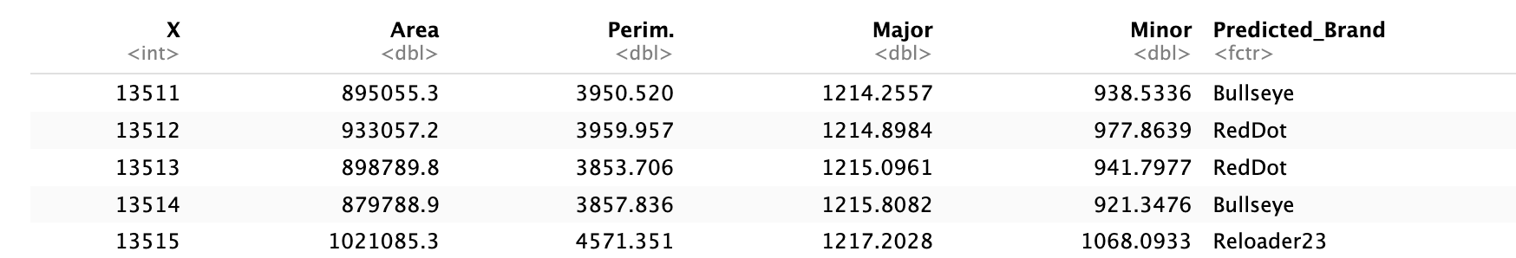
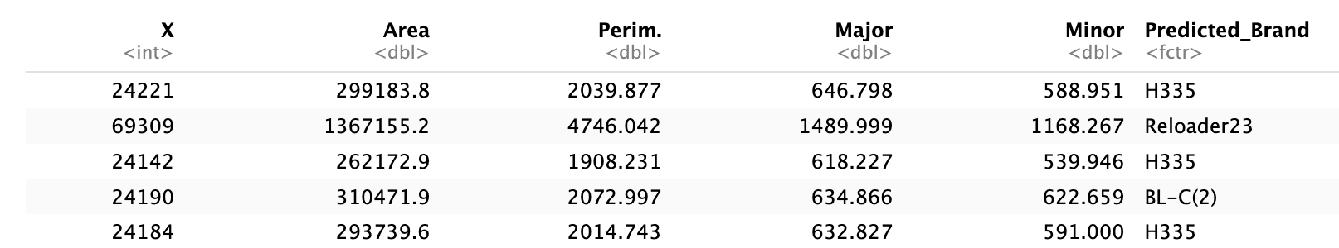
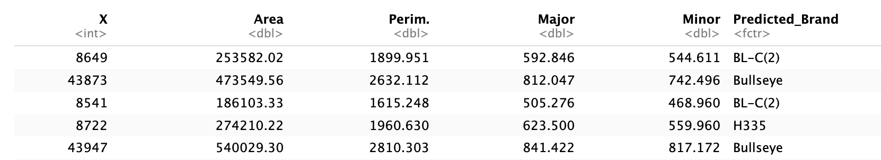
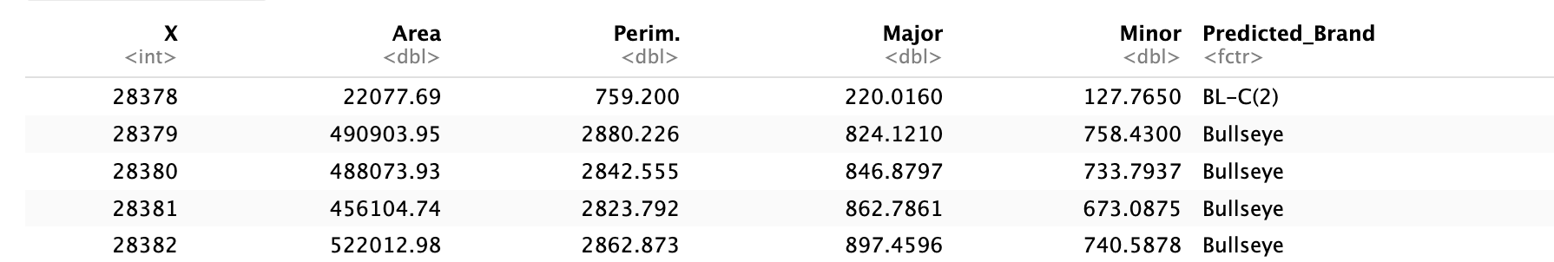
Brand Predictions Unexploded
Use the model to predict on the unexploded queries (1,2,4,5,6,7,8,10)
Output it as individual csv query files
Query 1
Query 5
Query 8
Query 2
Query 6
Query 10
Query 4
Query 7

Slide 8
Conclusion
We successfully built a model to predict the brands of particles for each queries
Took into consideration of Dr. Hietpas’ conjecture when processing the data and building the model
Things to do differently:
We got an okay accuracy. We definitely could try to increase that somehow (whether it’s from modifying how we process the data and model selections or something else)
We could evaluate the two separate models better. We needed more time to find out how to make the metrics calculation work.

Slide 9
References
https://towardsdatascience.com/understanding-gradient-boosting-machines-9be756fe76ab
Dr. Saunders’ Lectures
https://stats.stackexchange.com/questions/52239/how-does-cross-validation-work-in-rs-gbm-package
https://www.sciencedirect.com/science/article/abs/pii/S0379073823003304?via%3Dihub
https://www.rdocumentation.org/packages/stats/versions/3.6.2/topics/t.test
https://towardsdatascience.com/a-look-at-precision-recall-and-f1-score-36b5fd0dd3ec
https://chat.openai.com/c/338382ac-7e47-4006-b7f5-1dd32dd28319
https://www.r-bloggers.com/2021/04/random-forest-in-r/

